Slide 1
Module 1 MICROSOFT .NET FRAMEWORK USING C#

Slide 2
.NET Framework: Introduction, Common Language Runtime (CLR) , MSIL, The .NET Framework Class Library Introduction to C#: structure of a c# program, data types, operators, decision making branching and looping, arrays. Object oriented programming: Encapsulation, Inheritance, Polymorphism, Properties and indexers, Interfaces, Structures, Enumeration, Namespaces and Access specifiers, Partial classes, Partial methods, Delegates and Events, Attributes and Reflection
Syllabus-Module 1

Slide 3
.NET FRAMEWORK - INTRODUCTION
.NET Framework Developed by Microsoft.
The first version of .NET released in 2002.
The version - .Net Framework 1.0.
Platform made up of tools, programming languages(C#,VB.NET,J# etc), and libraries that are for building many different types of applications such as Desktop, Web, Mobile, etc.
.NET code to execute in different places such as Linux, macOS, Windows, iOS, Android, and many more.
The latest version is .Net Framework 4.8, in 2022.

Slide 4
.NET FRAMEWORK ADVANTAGES
C#
Code sharing
Improved security
Efficient data access
Better support for dynamic web
Language independence
Good design
Object-oriented programming
Zero-impact installation
Visual Studio

Slide 5
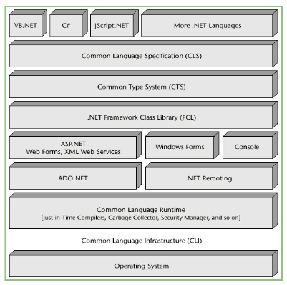
.NET FRAMEWORK ARCHITECTURE/COMPONENTS

Slide 6
.NET FRAMEWORK ARCHITECTURE/COMPONENTS
CTS (Common Type System)
CLS (Common Language Specification)
FCL (Framework Class Library)
IL/MIL/CIL
CLR (Common Language Runtime)
It specifies a standard that represents what type of data and value can be defined and managed in computer memory at runtime.
In.NET Framework, different Programming Languages and compiled into Common Intermediate Language or Microsoft Intermediate Language or Intermediate Language.
The Common Language Runtime (CLR) runs .NET applications on a given machine, converting the IL Code or MSIL Code, or CIL to machine code that the corresponding machine can execute.
CLS defines a set of features that are needed by many common applications. CLS is a subset of the CTS.
FCL provides the system functionality in the .NET framework as it has various classes, data types, interfaces, etc. to perform multiple functions and build different types of applications.

Slide 7
.NET FRAMEWORK ARCHITECTURE/COMPONENTS
JIT (Just-In-Time compiler)
ADO.NET (ActiveX Data Objects)
ASP.NET
Just-In-Time compiler is a part of Common Language Runtime (CLR).
The intermediate language is converted into the machine code by the Just-In-Time (JIT) compiler.
ADO.NET is a set of classes that expose data access services for .NET Framework programmers. It is an integral part of the .NET Framework, providing access to relational, XML, and application data.
ASP.NET is a web framework designed and developed by Microsoft. It is used to develop websites, web applications, and web services. It provides a fantastic integration of HTML, CSS, and JavaScript.

Slide 8
INTRODUCTION TO C# PROGRAMMING

Slide 9
INTRODUCTION
C# is a modern, object-oriented, and type-safe programming language.
It enables developers to build many types of secure and robust applications that run in .NET.
C# has its roots in the C family of languages and will be immediately familiar to C, C++, Java, and JavaScript programmers.

Slide 10
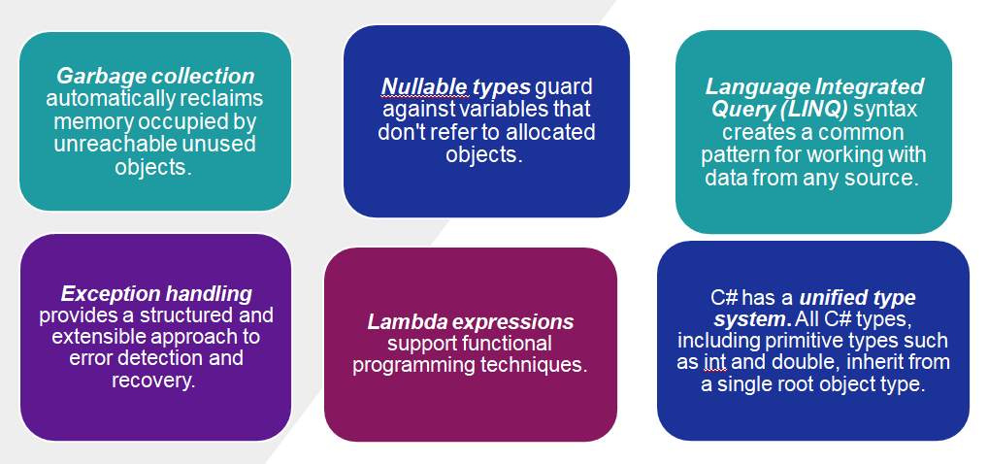
C# FEATURES

Slide 11


SETTING UP THE ENVIRONMENT IN C#
Basic Components involved in process of Setting up the environment in C# are:
.NET Framework
Visual Studio
VISUAL STUDIO

Slide 12
Console Applications
A console application is an application that can be run in the command prompt.
For any beginner on .NET or anyone who wants to learn C# Language or anyone who wants to become an expert in C# Language, building a console application is ideally the first step to learning the C# Language.
The Console Applications contain a similar user interface to the Operating systems like MS-DOS, UNIX, etc.
The Console Application is known as the CUI application because in this application we completely work with the CUI environment.
Console applications do not provide any GUI facilities like the Mouse Pointer, Colors, Buttons, Menu Bars, etc.

Slide 13
OBJECT ORIENTED CONCEPTS

Slide 14
Abstraction
Abstraction is "To represent the essential feature without representing the background details."
Abstraction lets you focus on what the object does instead of how it does it.
Abstraction provides a generalized view of your classes or objects by providing relevant information.
Abstraction is the process of hiding the working style of an object and showing the information about an object understandably.

Slide 15
Abstract Methods
A method without the body is known as Abstract Method, what the method contains is only the declaration of the method. That means the abstract method contains only the declaration, no implementation.
without writing the method body, if we end the method with a semicolon as follows, then it is called an Abstract Method.
If you want to make any method an abstract method, then you should explicitly use the abstract modifier. And once you use the abstract modifier, automatically the method is going to be called an abstract method.
public abstract void Add(int num1, int num2);

Slide 16
Abstract Class
A class under which we define abstract methods is known as an abstract class.
It is a restricted class that cannot be used to create objects (to access it, it must be inherited from another class).
When a class contains any abstract methods, then it must and should be declared using the abstract modifier and when a class is created using an abstract modifier then it is called an Abstract class in C#.
If you have a child class of an abstract class, then it is the responsibility of the child class to provide the implementation for all the abstract methods of the parent class. You cannot escape. Every method should be implemented. If you implement all the abstract methods, then only you can consume the non-abstract method of the Parent class.
public abstract class Calculator
{
public abstract void Add(int num1, int num2);
}

Slide 17
Encapsulation
Wrapping up a data member and a method together into a single unit (in other words, class) is called Encapsulation. Encapsulation is like enclosing in a capsule. That is, enclosing the related operations and data related to an object into that object.
Encapsulation means hiding the internal details of an object, in other words, how an object does something.
Encapsulation prevents clients from seeing its inside view, where the behavior of the abstraction is implemented.
Encapsulation is a technique used to protect the information in an object from another object.
Hide the data for security, such as making the variables private, and expose the property to access the private data that will be public.

Slide 18
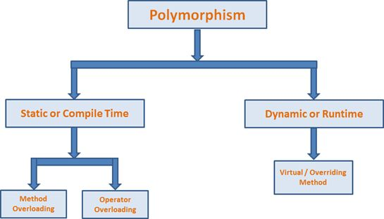
Polymorphism
Polymorphism is one of the features provided by Object Oriented Programming. Polymorphism simply means occurring in more than one form.
That is, the same entity (method or operator or object) can perform different operations in different scenarios.
Types of Polymorphism
Static / Compile Time Polymorphism
Dynamic / Runtime Polymorphism

Slide 19
Static or Compile Time Polymorphism
Method overloading is an example of Static polymorphism.
Overloading is the concept in which method names are the same with different parameters. The method/function has the same name but different signatures in overloading.
It is also known as Early binding.
It is also known as Compile Time Polymorphism because the decision of which method is to be called is made at compile time.
Here C# compiler checks the number of parameters passed and the parameter type, decides which method to call, and throws an error if no matching method is found.

Slide 20
Method Overriding
During inheritance in C#, if the same method is present in both the superclass and the subclass. Then, the method in the subclass overrides the same method in the superclass. This is called method overriding.
In this case, the same method will perform one operation in the superclass and another operation in the subclass.
We can use virtual and override keywords to achieve method overriding.

Slide 21
Inheritance
In C#, inheritance allows us to create a new class from an existing class. It is a key feature of Object-Oriented Programming (OOP).
The class from which a new class is created is known as the base class (parent or superclass). And, the new class is called derived class (child or subclass)
The derived class inherits the fields and methods of the base class. This helps with the code reusability in C#.

Slide 22
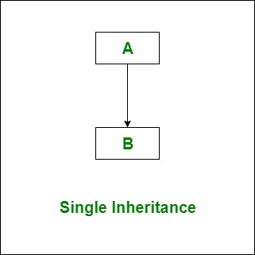
Types of Inheritance
Single Inheritance
p;[iooiihjhbnbvn
In single inheritance, subclasses inherit the features of one superclass. In the image, the class A serves as a base class for the derived class B.

Slide 23
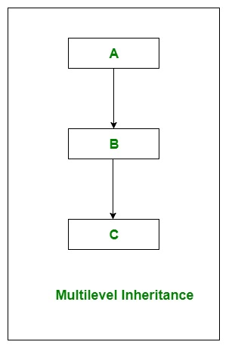
2. Multi-level Inheritance
In Multilevel Inheritance, a derived class will be inheriting a base class and as well as the derived class also act as the base class to other class. In the image, class A serves as a base class for the derived class B, which in turn serves as a base class for the derived class C.

Slide 24
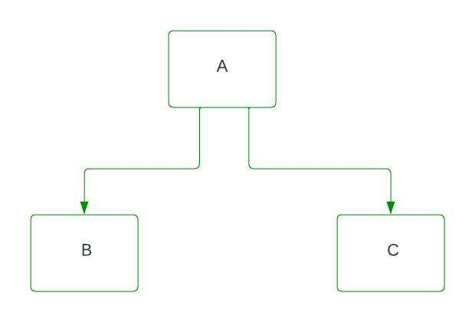
3. Hierarchical Inheritance
In Hierarchical Inheritance, one class serves as a superclass (base class) for more than one subclass. In below image, class A serves as a base class for the derived class B and C.

Slide 25
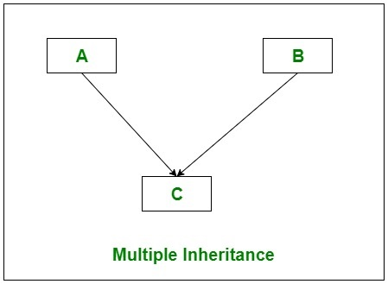
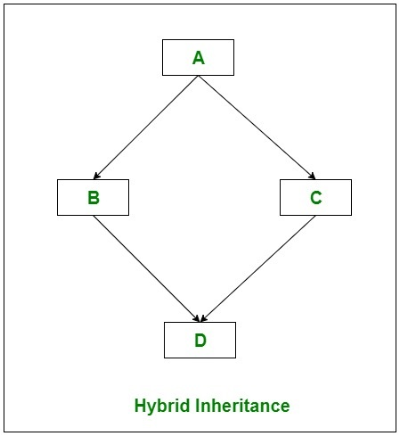
C# does not support multiple inheritance and Hybrid inheritance.
Multiple Inheritance Hybrid Inheritance
Both the Inheritances achieved through Interfaces.
In Multiple inheritance, one class can have more than one superclass and inherit features from all parent classes.
It is a mix of two or more types of inheritance.

Slide 26
Structure of a C# Program
using System;
class Program
{
static void Main()
{
// Main method is the entry point of the program
Console.WriteLine("Hello, World!"); // Statement to print text
}
}

Slide 27
Datatypes in C#
Variable Data Types:
Data Type | Description | Example
bool | Represents true or false values. | bool isTrue = true;
byte | 8-bit unsigned integer. | byte age = 25;
sbyte | 8-bit signed integer. | sbyte temperature = -5;
short | 16-bit signed integer. | short count = 1000;
ushort | 16-bit unsigned integer. | ushort quantity = 500;
int | 32-bit signed integer. | int score = 95;
uint | 32-bit unsigned integer. | uint total = 10000;
long | 64-bit signed integer. | long population = 1000000;
ulong | 64-bit unsigned integer. | ulong distance = 500000;
float | 32-bit floating-point number. | float price = 10.99f;
double | 64-bit floating-point number. | double PI = 3.14159;
decimal | 128-bit decimal type. | decimal salary = 5000.50m;
char | 16-bit Unicode character. | char grade = 'A';

Slide 28
Datatypes in C#
Reference Types:
Data Type | Description | Example
string | Represents a sequence of characters. | string name = "John";
object | Base type of all other types. | object obj = new object();
dynamic | Represents an object whose operations will be resolved at runtime. | dynamic dyn = 10;

Slide 29
Datatypes in C#
Pointer Types:
Data Type | Description | Example
unsafe | Used to declare pointers. | unsafe { }
* | Pointer declaration symbol. | int* ptr;
fixed | Used to pin variables in memory. | fixed (int* p = &someVariable) { }

Slide 30
Operators
Operators are symbols that perform operations on operands. C# supports arithmetic, comparison, logical, and assignment operators.
int a = 5;
int b = 3;
int sum = a + b; // Addition
int difference = a - b; // Subtraction
int product = a * b; // Multiplication
int quotient = a / b; // Division
bool isEqual = (a == b); // Equality check
bool isGreater = (a > b); // Greater than check
bool logicalAnd = (a > 0) && (b > 0); // Logical AND
bool logicalOr = (a > 0) || (b > 0); // Logical OR

Slide 31
Control Structures
There may be situations where the programmer is required to alter the normal flow of execution of a program or to perform the same operation a no. of times.
Various control statements supported by c are-
Decision control statements
Loop control statements

Slide 32
Decision Control Statements
Decision control statements alter the normal sequential execution of the statements of the program depending upon the test condition to be carried out at a particular point in the program.
Decision control statements supported by c are:-
if statement
if-else statement
Else if Ladder
Nested If
switch statement

Slide 33
Flowchart
Condition
False
if (condition)
{
// Code to execute if the condition is true
}
True
Block of if
Next statement
STOP

Slide 34
if – else statement
In the case of an if statement, the block of statements is executed only when the condition is true otherwise the control is transferred to the next statement following the if block.
But if specific statements are to be executed in both cases (either condition is true or false) then an if-else statement is used.
In if – else statement a block of statements is executed if the condition is true but a different block of statements is executed when the condition is false.
Syntax: if (condition)
{
statement 1;
statement 2;
}
else
{
statement 3;
}
Test
Condition
False
True
Block of if
Block of else
Next statement
STOP

Slide 35
Switch statement
The switch is a multi-way decision-making statement that selects one of the several alternatives based on the value of a single variable or expression.
It is mainly used to replace multiple if-else-if statements.
The if-else-if statement causes performance degradation as several conditions need to be evaluated before a particular condition is satisfied.
Syntax: switch (expression)
{
case constant1 : statement (s); [break;]
case constant2 : statement (s); [break;]
…………………………………….
default: statement (s); [break;]
}

Slide 36
Syntax - switch
switch (expression)
{
case value1:
// Code to execute if expression == value1
break;
case value2:
// Code to execute if expression == value2
break;
// You can have any number of case statements
default:
// Code to execute if none of the cases match
break;
}

Slide 37
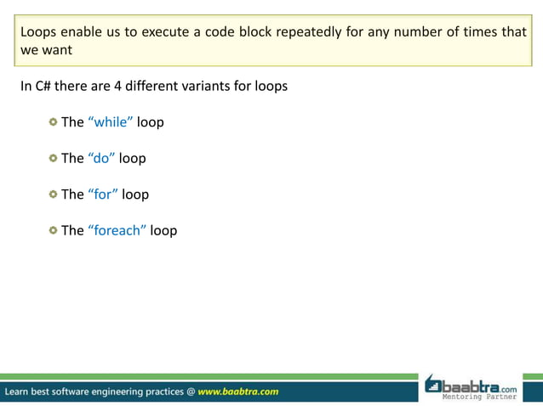

Slide 38
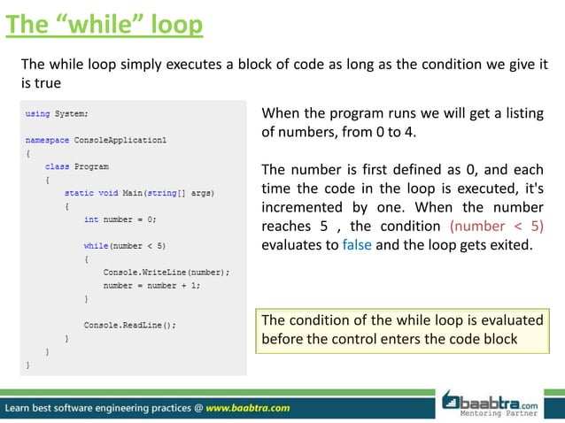

Slide 39
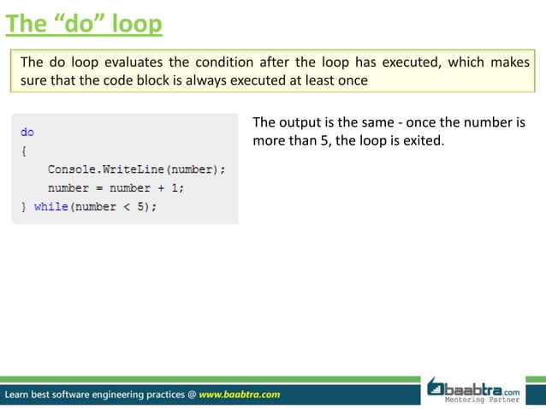

Slide 40
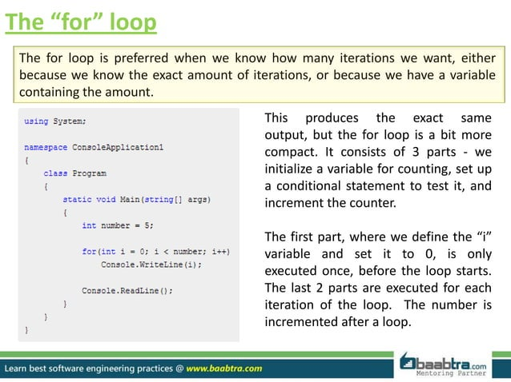

Slide 41
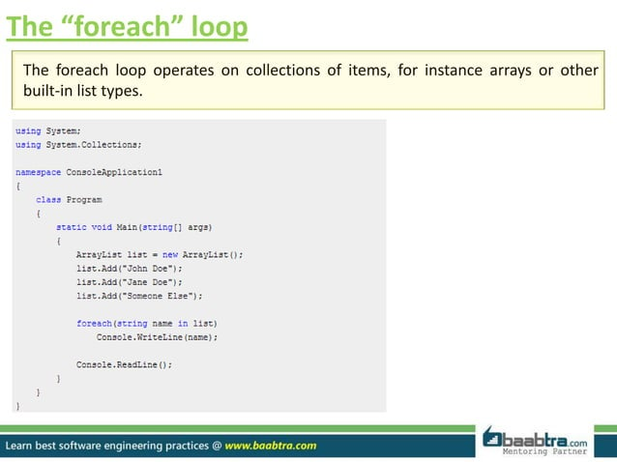

Slide 42
